Slide 1
Sensor NodeMCU Platform for Internet of Things
Dr. Y S Rao
ysrao@spit.ac.in

Slide 2


















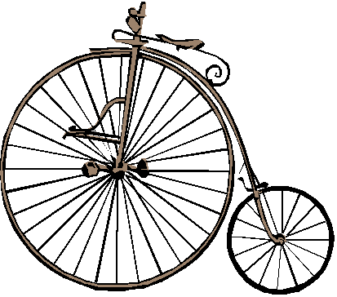
Beware of the computer!
computers + SoCs = hardware / software mix
complete change in device interaction
ever-growing number of critical applications

Slide 3
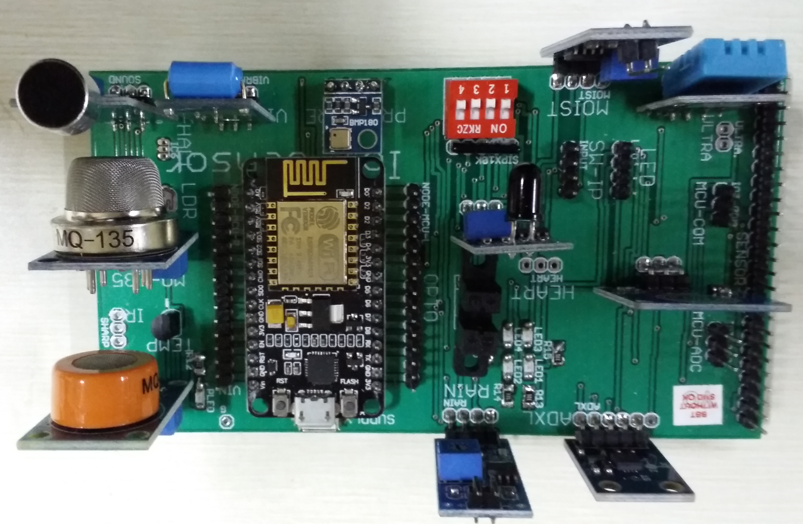
IoT Sensor NodeMCU Platform

Slide 4
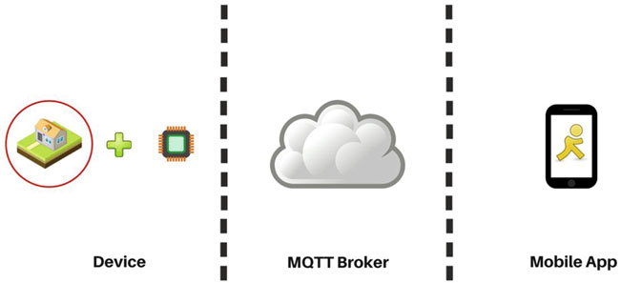
IoT Patterns: Real-time Clients Ex: Components of the intrusion detection system

Slide 5
Algorithm
Read motion sensor data from MCU
Publish sensor data to an MQTT broker
Build an Android app that subscribes to an MQTT broker
Display a notification in the app whenever a new message is published to the MQTT broker

Slide 6
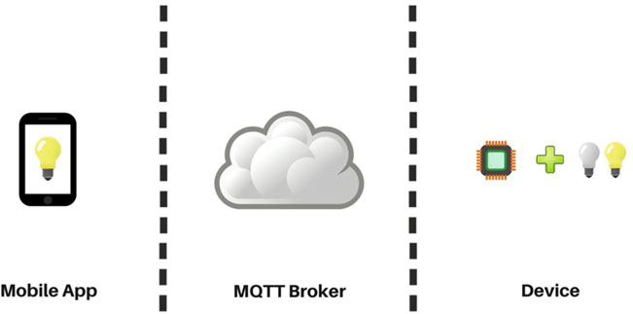
IoT Patterns: Remote Control EX: Components of the lighting control system

Slide 7
Algorithm
Write code to turn LEDs connected to Arduino on or off
Subscribe MCU to an MQTT broker
Build an Android app that publishes to an MQTT broker

Slide 8
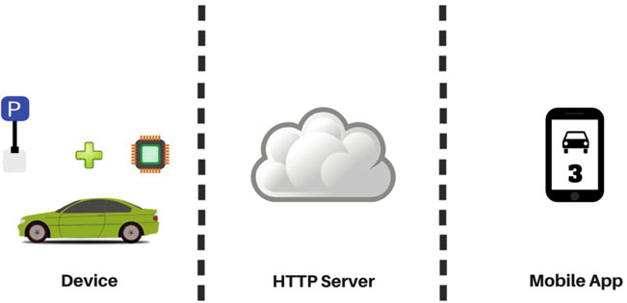
IoT Patterns: On-Demand Clients EX: Components of the smarter parking system

Slide 9
Algorithm
Read data from a proximity sensor
Send sensor data to a server (Database Table MySQL) server using HTTP
PHP Code (The first service will receive the MCU sensor data in an HTTP request and accordingly update the open parking spots count to the database. The second service will act as an interface for the iOS app—it will return data in a format that the iOS app can parse and display)
Display sensor data in an iOS app using HTTP

Slide 10
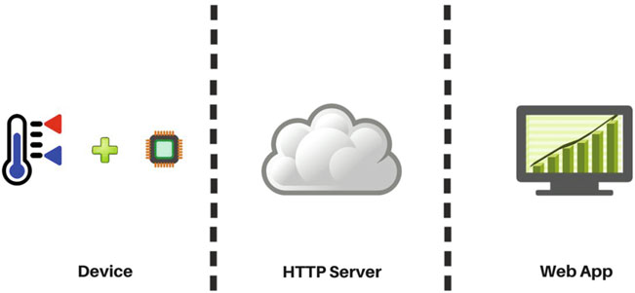
IoT Patterns: Web Apps EX: Components of the temperature monitoring system

Slide 11
Algorithm
Read data from a temperature sensor
Publish sensor data to a server
Display sensor data in a web-based dashboard

Slide 12
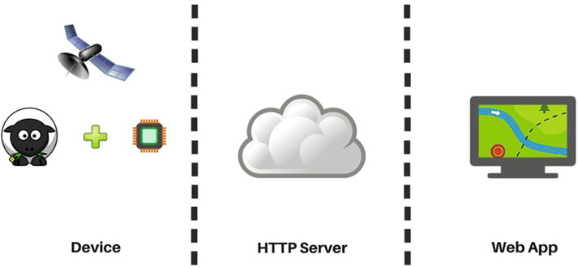
IoT Patterns: Location Aware EX: The components of livestock tracking system

Slide 13
Algorithm
Read GPS coordinates
Publish GPS coordinates to a server
Display GPS coordinates in a map

Slide 14
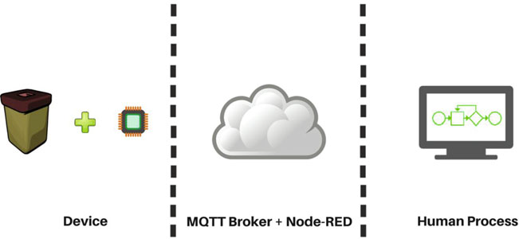
IoT Patterns: Machine to Human EX: Cloud based Components of the waste management system

Slide 15
Algorithm
Read data from a proximity sensor
Publish message to an MQTT broker
Build a workflow in Effektif (renamed to Signavio Workflow)
Create a Node-RED flow and initiate it from MCU
Effektif Workflow:
Effektif is a cloud-based platform that lets you automate routine workflows and processes into applications within minutes. For the purposes of this project, you can sign up for their free 30-day trial membership. You are going to define a very simple single step workflow that allows a person to enter a garbage pickup schedule.
https://app.effektif.com/

Slide 16
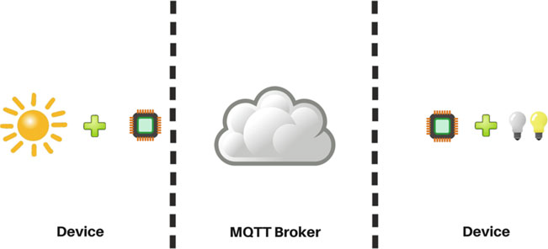
IoT Patterns: Machine to Machine EX: Components of an energy conservation system

Slide 17
Algorithm
Read data from a light sensor
Publish messages to an MQTT broker
Control LEDs
Subscribe MCU to an MQTT broker

Slide 18
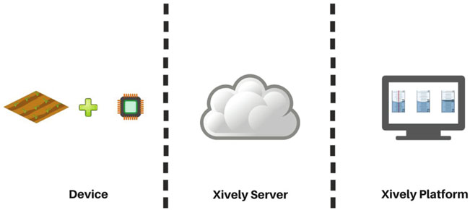
IoT Platforms EX: Components of the soil moisture control system

Slide 19
Xively Platform
Read soil moisture sensor data
Set up Xively to receive moisture sensor data
Set up a trigger in Xively to send an e-mail using a Zapier task
Write code to read the moisture sensor data and publish it to Xively
https://personal.xively.com/ .

Slide 20
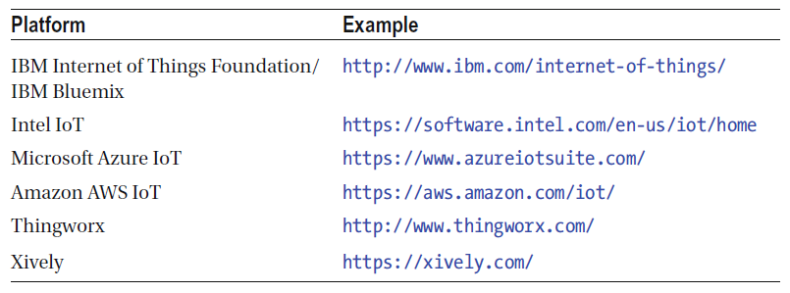
Major IoT Platforms

Slide 21
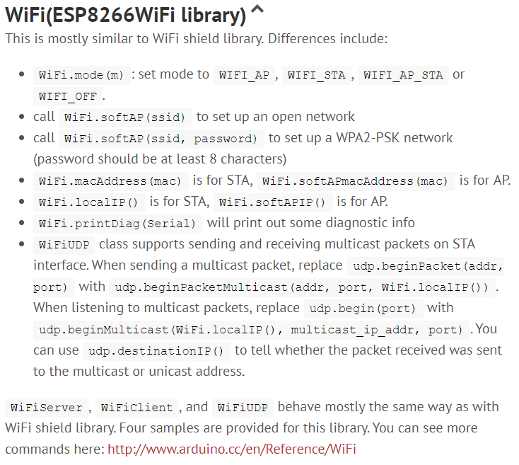

Slide 22
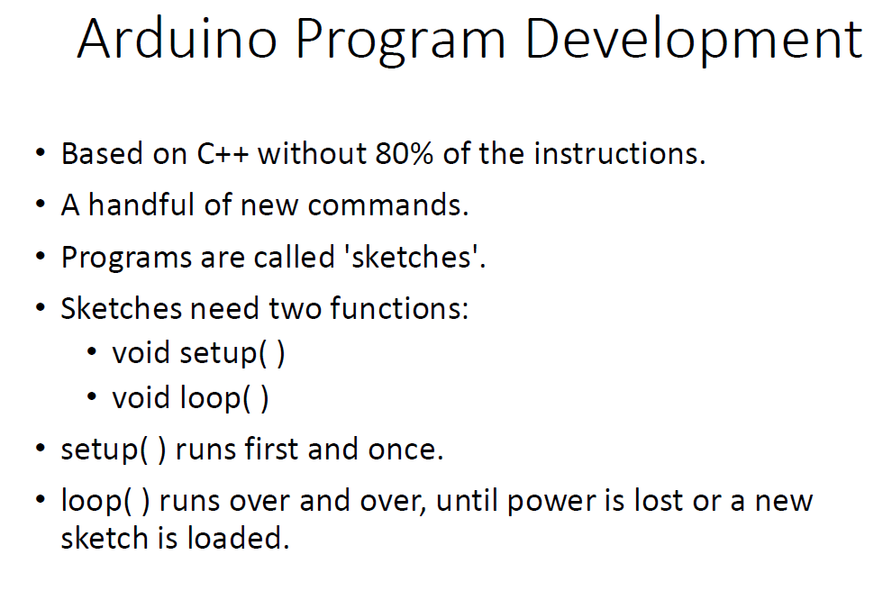

Slide 23
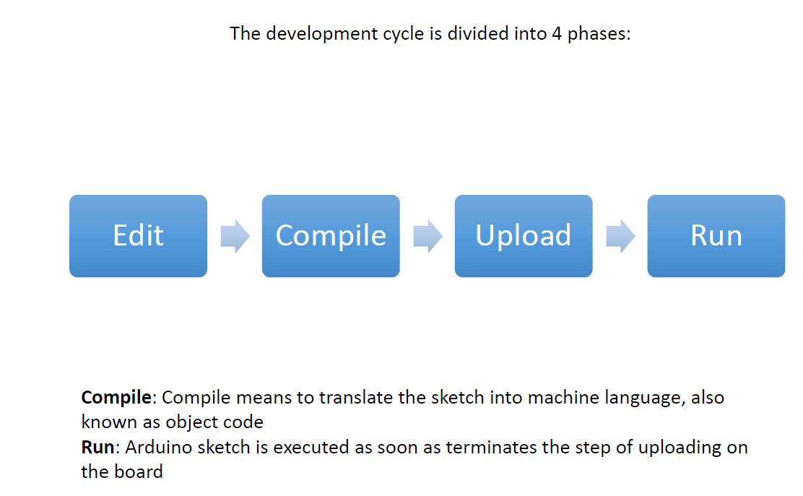

Slide 24
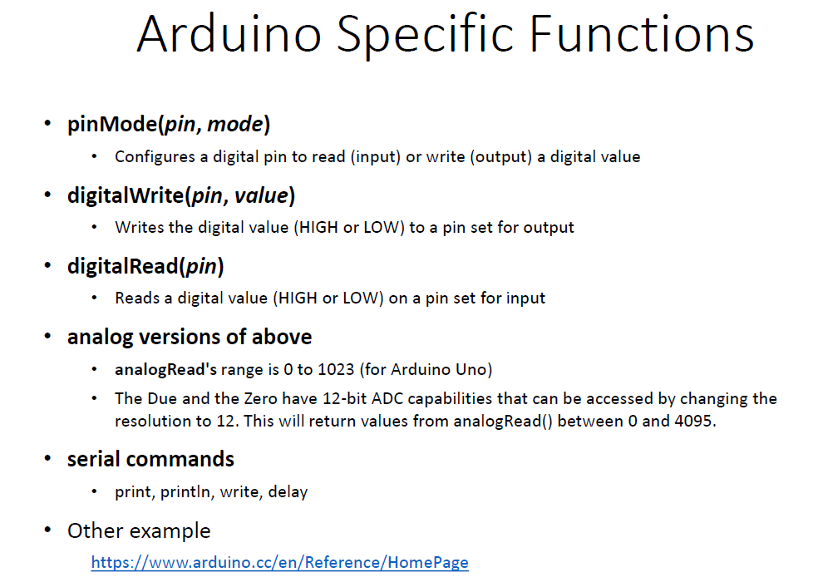

Slide 25
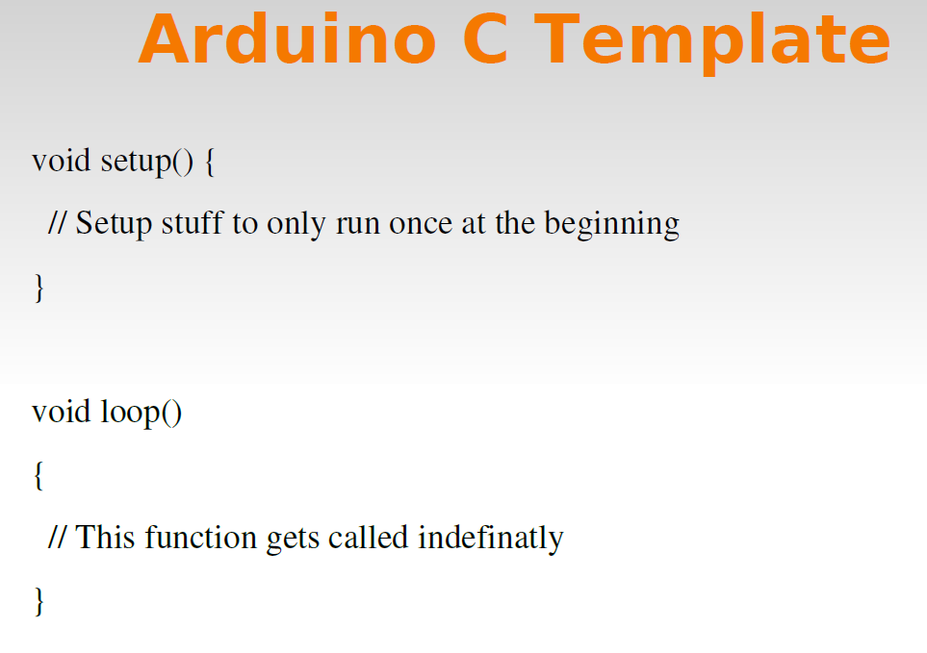

Slide 26
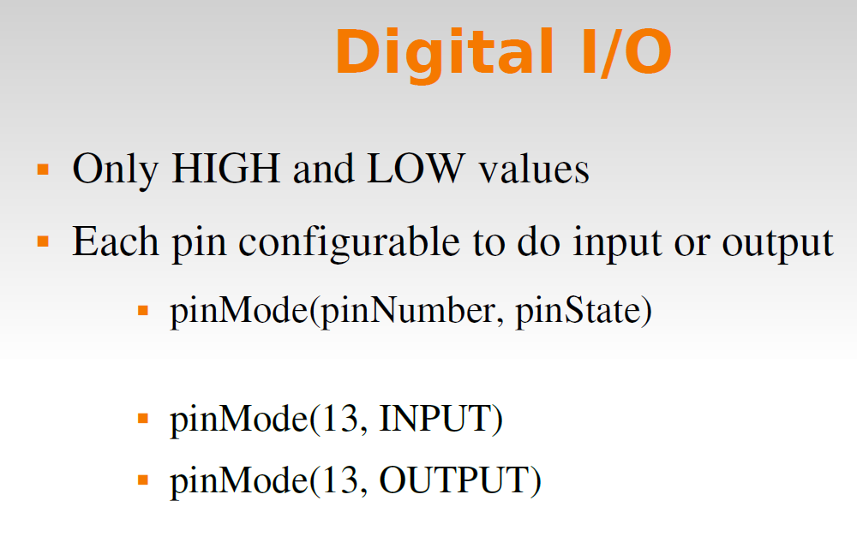

Slide 27
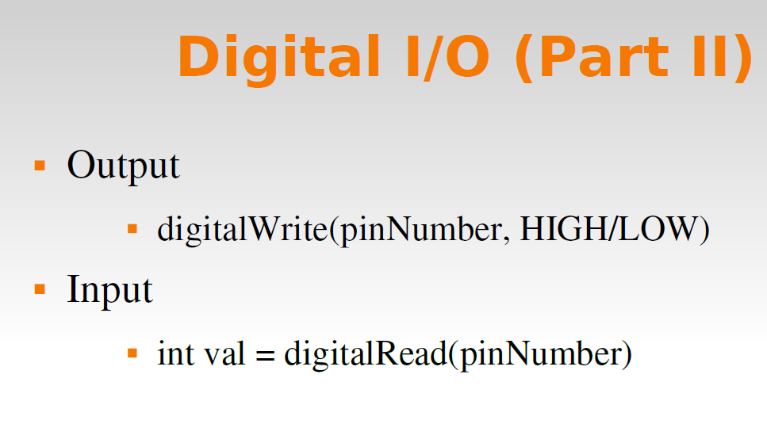

Slide 28
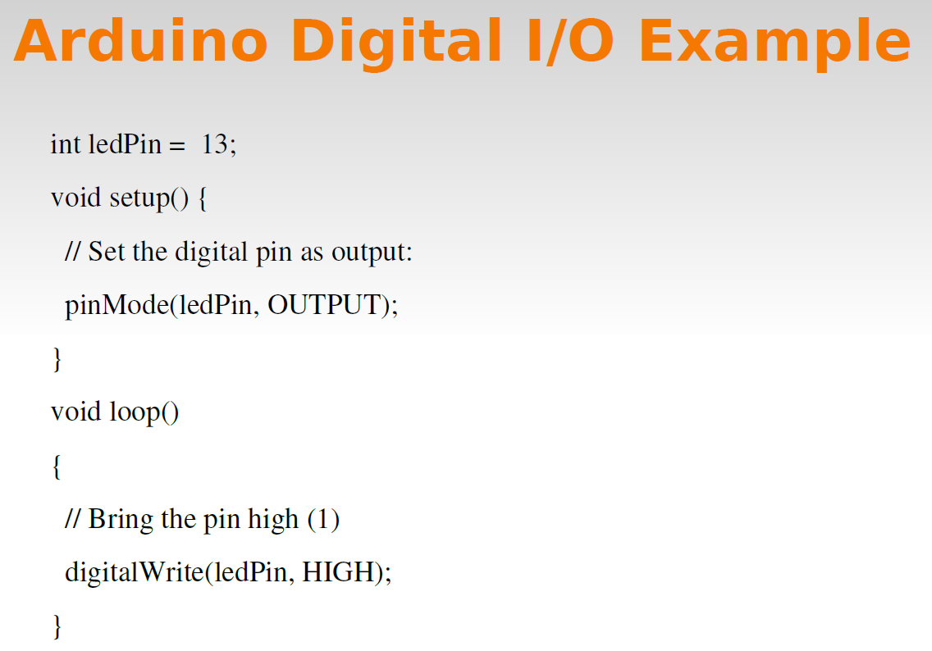

Slide 29
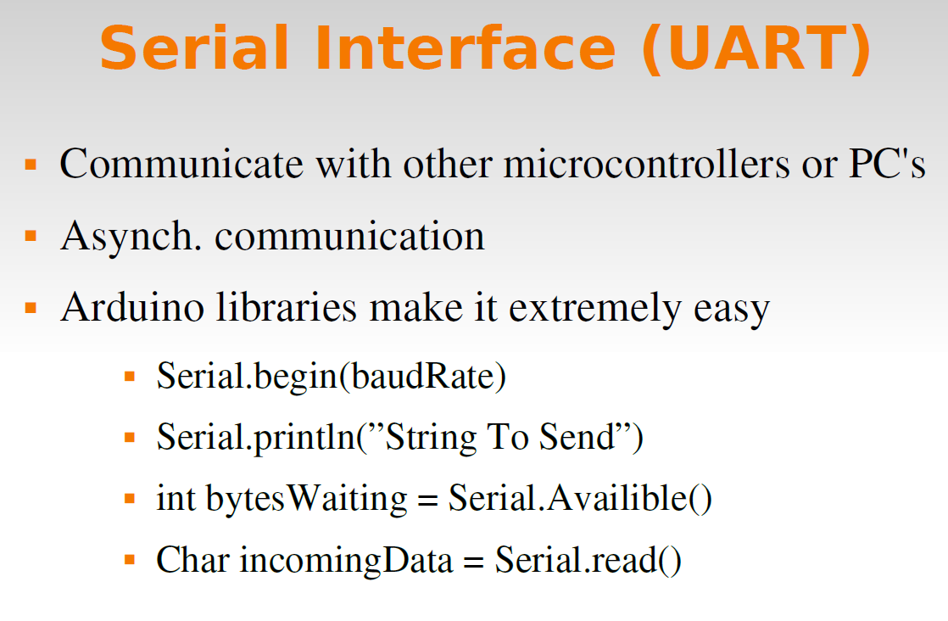

Slide 30
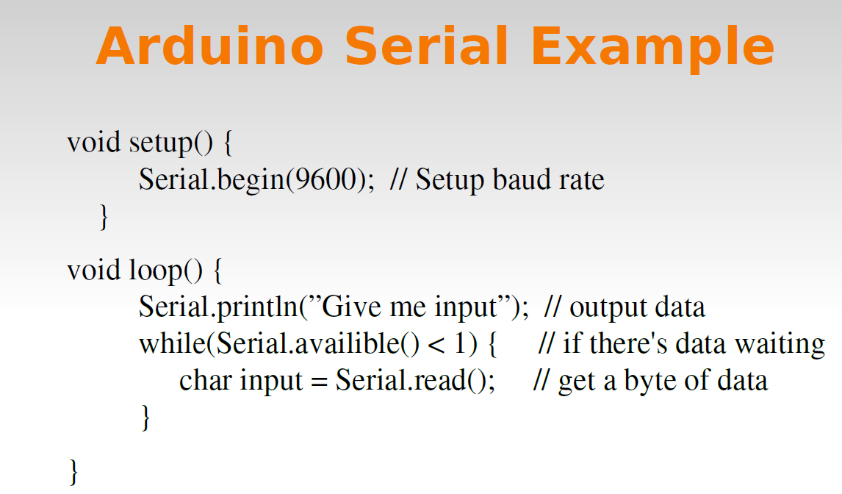

Slide 31
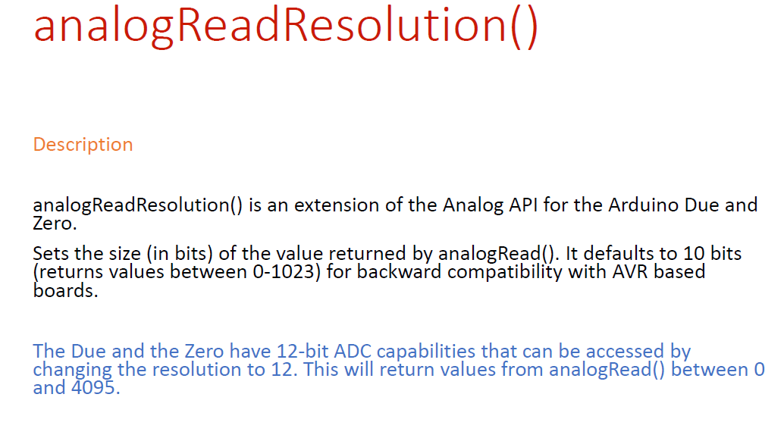

Slide 32
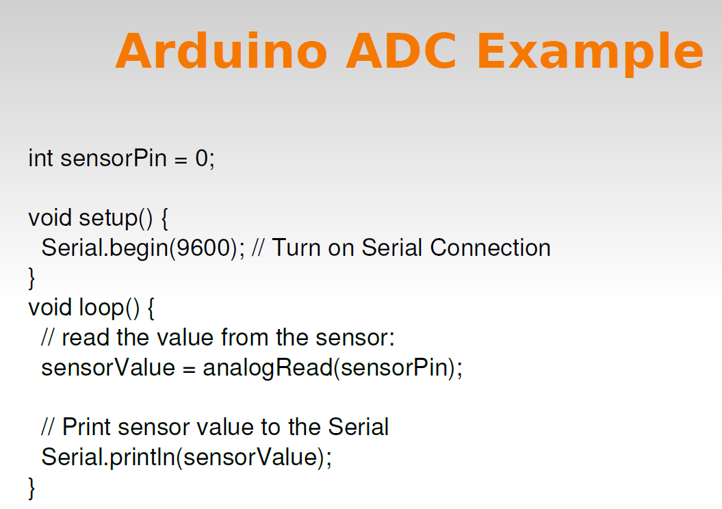

Slide 33
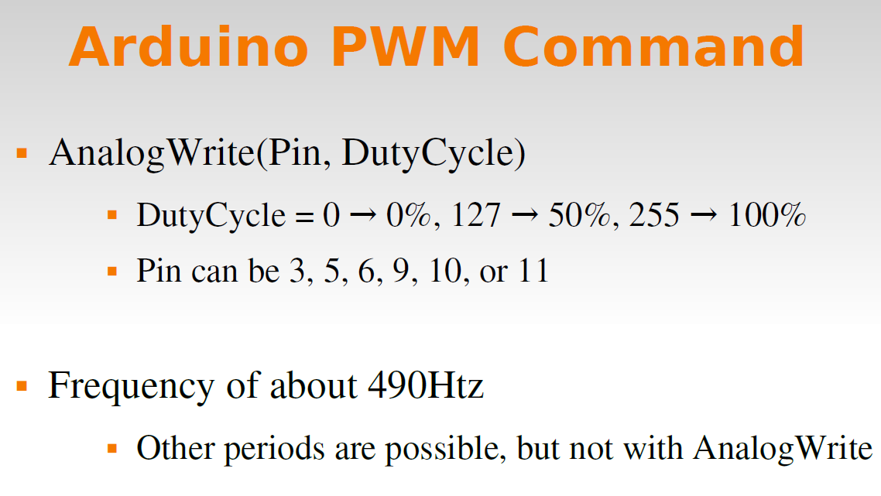

Slide 34
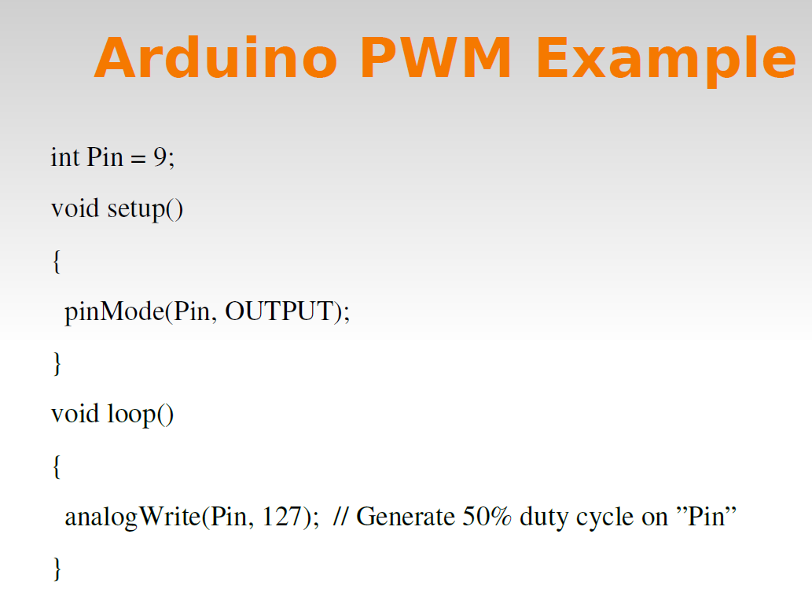

Slide 35
NodeMCU Code Examples: Control GPIO
ledPin = 1 swPin = 2 gpio.mode(ledPin,gpio.OUTPUT) gpio.write(ledPin,gpio.HIGH) gpio.mode(swPin,gpio.INPUT) print(gpio.read(swPin))

Slide 36
NodeMCU Code Examples: Connect to an AP
print(wifi.sta.getip())
--nil
wifi.setmode(wifi.STATION)
wifi.sta.config{ssid="SSID",pwd="password"}
-- for older versions of the firmware wifi.sta.config("SSID","password")
-- wifi.sta.connect() not necessary because wifi.sta.config sets auto-connect = true
tmr.create():alarm(1000, 1, function(cb_timer)
if wifi.sta.getip() == nil then
print("Connecting...")
else
cb_timer:unregister()
print("Connected, IP is "..wifi.sta.getip())
end
end)

Slide 37
NodeMCU Code Examples: HTTP request
-- A simple HTTP client
conn = net.createConnection(net.TCP, 0)
conn:on("receive", function(sck, payload) print(payload) end)
conn:on("connection", function(sck)
sck:send("GET / HTTP/1.1\r\nHost: nodemcu.com\r\n" .. "Connection: keep-alive\r\nAccept: */*\r\n\r\n") end)
conn:connect(80, "nodemcu.com")
Doing something similar using the HTTP module:
http.get("http://nodemcu.com", nil, function(code, data)
if (code < 0) then
print("HTTP request failed")
Else
print(code, data) end
end)

Slide 38
NodeMCU Code Examples: HTTP server
-- a simple HTTP server
srv = net.createServer(net.TCP)
srv:listen(80, function(conn)
conn:on("receive", function(sck, payload) print(payload)
sck:send("HTTP/1.0 200 OK\r\nContent-Type: text/html\r\n\r\n<h1> Hello, NodeMCU.</h1>") end)
conn:on("sent", function(sck) sck:close() end) end)

Slide 39
NodeMCU Code Examples: Connect to MQTT Broker
-- init mqtt client with keepalive timer 120sec
m = mqtt.Client("clientid", 120, "user", "password")
-- setup Last Will and Testament (optional)
-- Broker will publish a message with qos = 0, retain = 0, data = "offline"
-- to topic "/lwt" if client don't send keepalive packet
m:lwt("/lwt", "offline", 0, 0)
m:on("connect", function(con) print ("connected") end)
m:on("offline", function(con) print ("offline") end)
-- on publish message receive event
m:on("message", function(conn, topic, data)
print(topic .. ":" )
if data ~= nil then
print(data)
end end)
-- for secure: m:connect("192.168.11.118", 1880, 1)
m:connect("192.168.11.118", 1880, 0, function(conn) print("connected") end)
-- subscribe topic with qos = 0 m:subscribe("/topic",0, function(conn) print("subscribe success") end)
-- or subscribe multiple topic (topic/0, qos = 0; topic/1, qos = 1; topic2 , qos = 2)
-- m:subscribe({["topic/0"]=0,["topic/1"]=1,topic2=2}, function(conn) print("subscribe success") end)
-- publish a message with data = hello, QoS = 0, retain = 0
m:publish("/topic","hello",0,0, function(conn) print("sent") end)
m:close();
-- you can call m:connect again

Slide 40
NodeMCU Code Examples: UDP client and server
-- a udp server
s=net.createServer(net.UDP)
s:on("receive",function(s,c) print(c) end)
s:listen(5683)
-- a udp client cu=net.createConnection(net.UDP) cu:on("receive",function(cu,c) print(c) end) cu:connect(5683,"192.168.18.101") cu:send("hello")

Slide 41
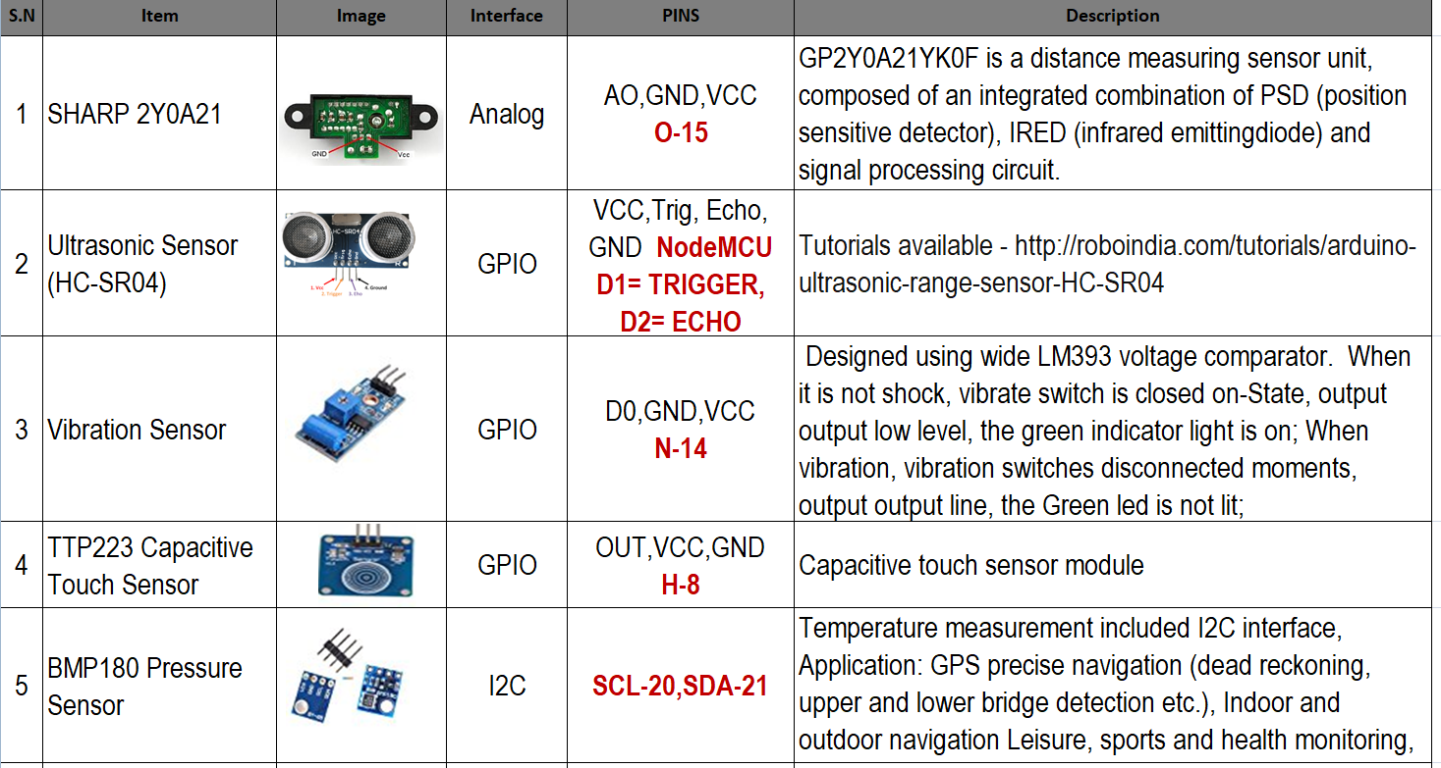

Slide 42
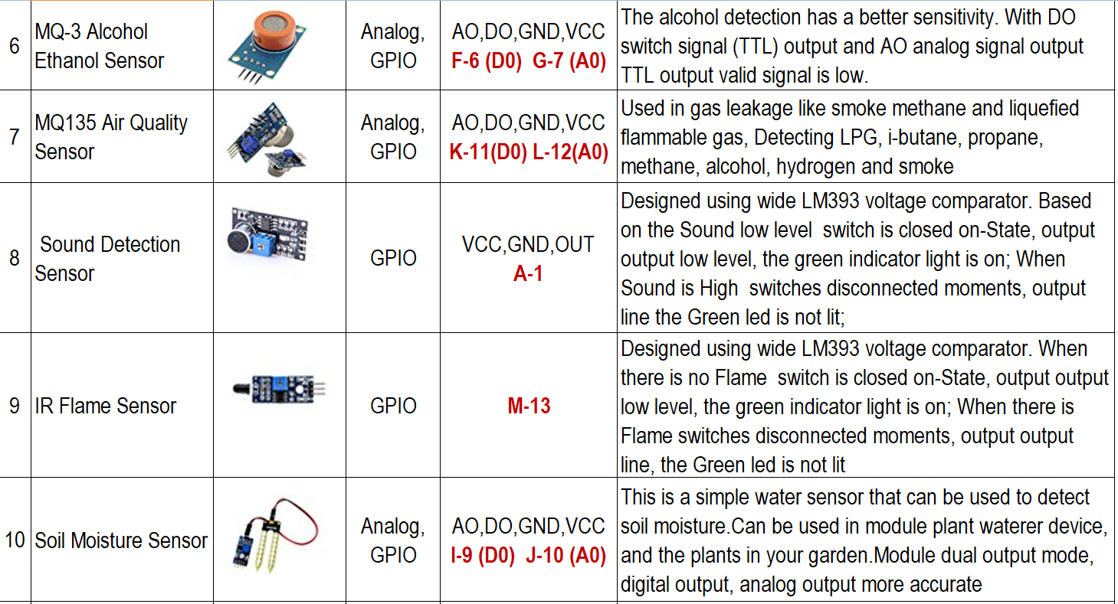

Slide 43
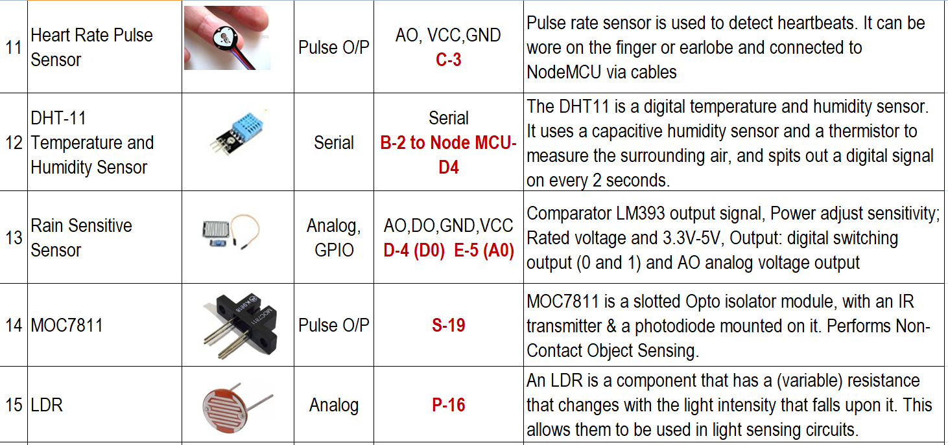

Slide 44
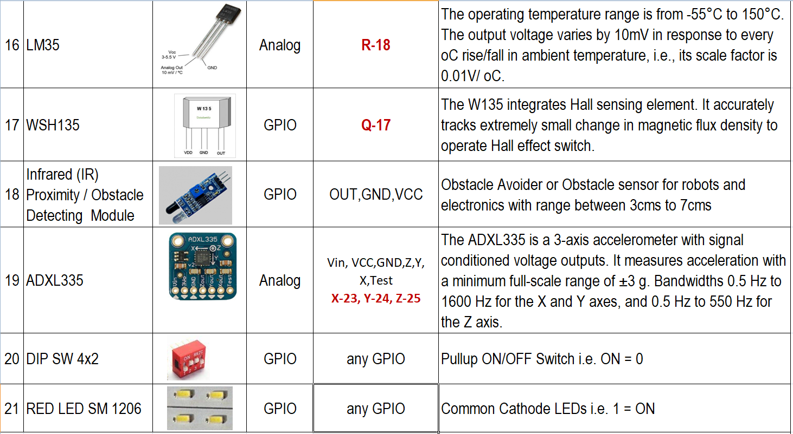

Slide 45

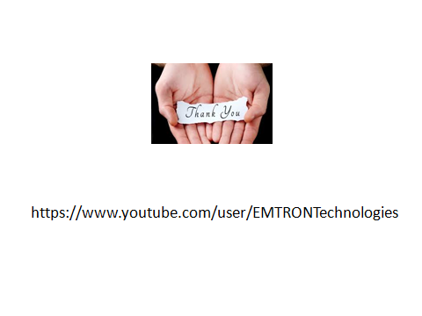
Thank You!!
Emtron Technologies Flat No-101, B3 Wing, 1st Floor, Divyam Hights, Gilbert Hill, Shreenath Nagar, Andheri –West, Mumbai-58 +91-9820962870 E-mail: emtron.tech@gmail.com, www.emtrontech.in

